Slide 1

Machine Learning #10
Module Leader: Dr Grace U. Nneji

Slide 2
01
Rules
02
Learning outcomes
CONTENTS
02
References
04
Principal Component Analysis (PCA)
05
PCA Algorithm
06
PCA in scikit-learn & Example
07
Seminar Session

Slide 3

01
Rules
Be on time
Bring your stuff (Pen, papers, folder, brain)
No pressing of phone, or gaming in the class.
Habit of Effective learners.
Prepare for your coursework and exam on time.
Always revise your PPTs before and after class.
Have Fun

Slide 4
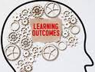
02
Learning Outcomes
Students will be able to:
understand the concept and structure on how to use unsupervised learnng other algorithms like PCA.
grasp the idea of dimensionality reduction techniques like PCA which aims to reduce the number of features while perserving the vital patterns in the data.
interprete and visualize the results of unsupervised learning approaches and make data-driven decisions.
understand how to tune hyperparameters and evaluate the performance metrics.

Slide 5

03
References
1. Bishop, C. M. (2006). Pattern Recognition and Machine Learning. Springer.
2. Géron, A. (2019). Hands-On Machine Learning with Scikit-Learn, Keras, and TensorFlow. O'Reilly Media.
3. Murphy, K. P. (2012). Machine Learning: A Probabilistic Perspective. MIT Press.
4. Goodfellow, I., Bengio, Y., & Courville, A. (2016). Deep Learning. MIT Press.
5. Hastie, T., Tibshirani, R., & Friedman, J. (2009). The Elements of Statistical Learning: Data Mining, Inference, and Prediction. Springer.

Slide 6
Principal Component Analysis (PCA)
04

Slide 7
04
Principal Component Analysis (PCA)
PCA is an algorithm that is commonly used for data visualization.
Specifically, if you have a dataset with a lot of features, say 10 features or 50 features or even thousands of features, you can't plot 1,000 dimensional data.
PCA, or principal components analysis is an algorithm that lets you take data with a lot of features, 50, 1,000, even more, and reduce the number of features to two features, maybe three features, so that you can plot it and visualize it.
It is commonly used by data scientists to visualize the data, to figure out what might be going on.

Slide 8
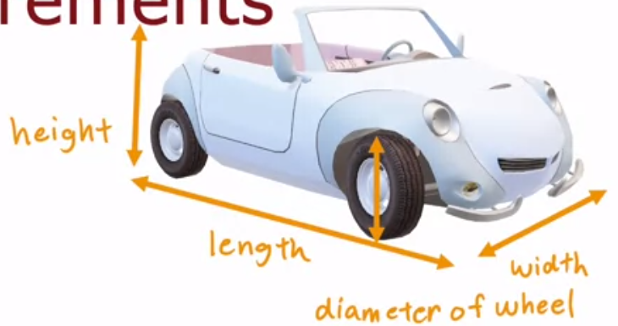
04
Principal Component Analysis (PCA)
Let consider an example of a passenger car with lot of features such as length of the car, the width of the car, the height of the car, diameter of the wheel, and many other features of cars.
If you want to reduce the number of features so you can visualize it, how can you use PCA to do so?

Slide 9
04
Principal Component Analysis (PCA)
If you want to reduce the number of features so you can visualize it, how can you use PCA to do so?
Let’s consider a scenario 1, where the length of the car should represent x₁ (which varies quite a bit) and width of the car as x₂ (which doesn’t vary much as 1.8m or 6 feet).
If you want to reduce the number of features, well, one thing you could do is to take x₁ because x₂ varies relatively little from car to car.
It turns out that PCA is an algorithm that when applied to this data set will more or less automatically decide to just take x_1, but it can do much more than that.

Slide 10
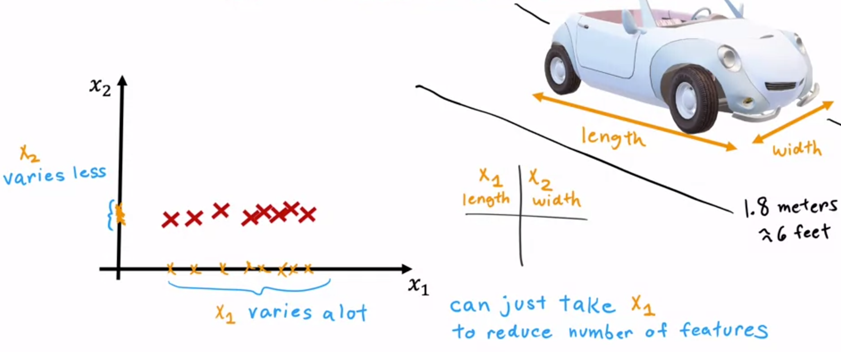
04
Principal Component Analysis (PCA)
Scenario 1

Slide 11
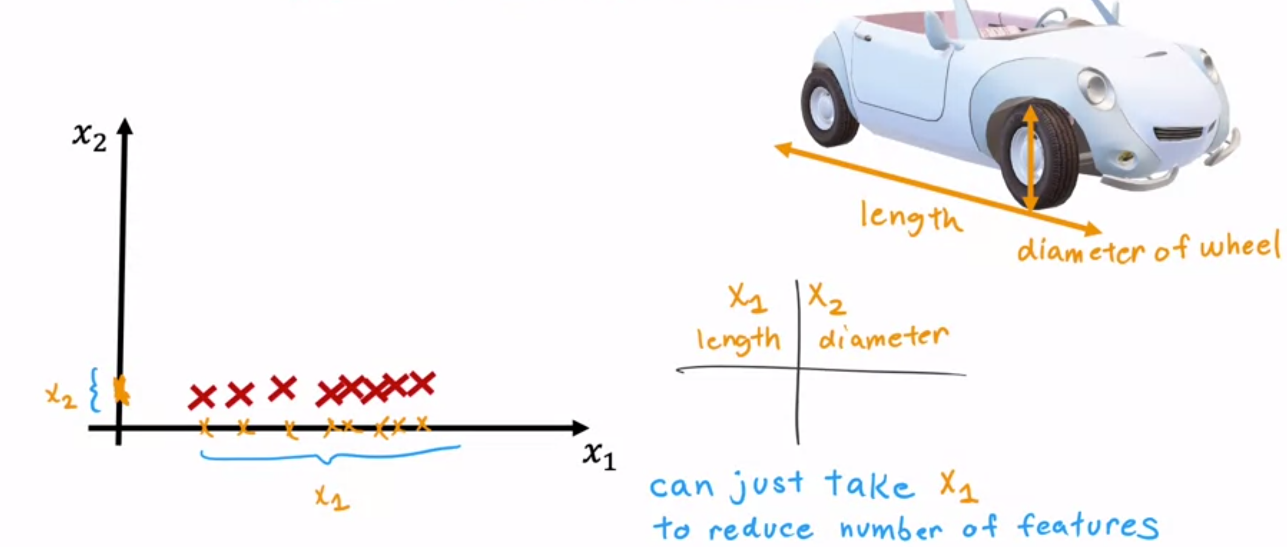
04
Principal Component Analysis (PCA)
Let’s consider scenario 2, where the length of the car should represent x₁ (which varies quite a bit) and the diameter of the wheel as x₂ (which does vary a little bit).
If you were to plot the data and considering simplifying it into just one feature, you might decide to take x₁ and forget x₂ .
PCA when applied to this dataset would more or less, cause you to just check the feature x₁.
In both the scenarios, only one of the two features seemed to have a meaningful degree of variation.
Scenario 2

Slide 12
04
Principal Component Analysis (PCA)
Let’s consider a complex example, scenario 3, where the length of the car should represent x₁ (which varies quite a bit) and the height of a car as x₂ (which also varies quite a bit), since some cars are much taller than other cars.
If you’re to plot the data with both variation in the length & height, what should you pick?
You don't want to pick just x₁, the length, and ignore x_{2 ,} the height and you also don't want to pick just x₂ , and ignore x₁. Then, it seems as if both x₁ and x₂ have useful information.
Therefore, there is need to introduce a new axis, z which is the combination of x₁ and x_{2.}
Recall, instead of needing two numbers corresponding to the coordinates on x₁ and x₂ axes, the length and height. We just need a few numbers, in this case, only one number (coordinate on the z-axis) instead of two, to capture roughly the size of the car.
In practice, PCA is commonly used to reduce a very large number of features, say 10, 20, 50, even thousands of features, down to maybe two or three features so that you can visualize the data in a two-dimensional or in a three-dimensional plot.

Slide 13
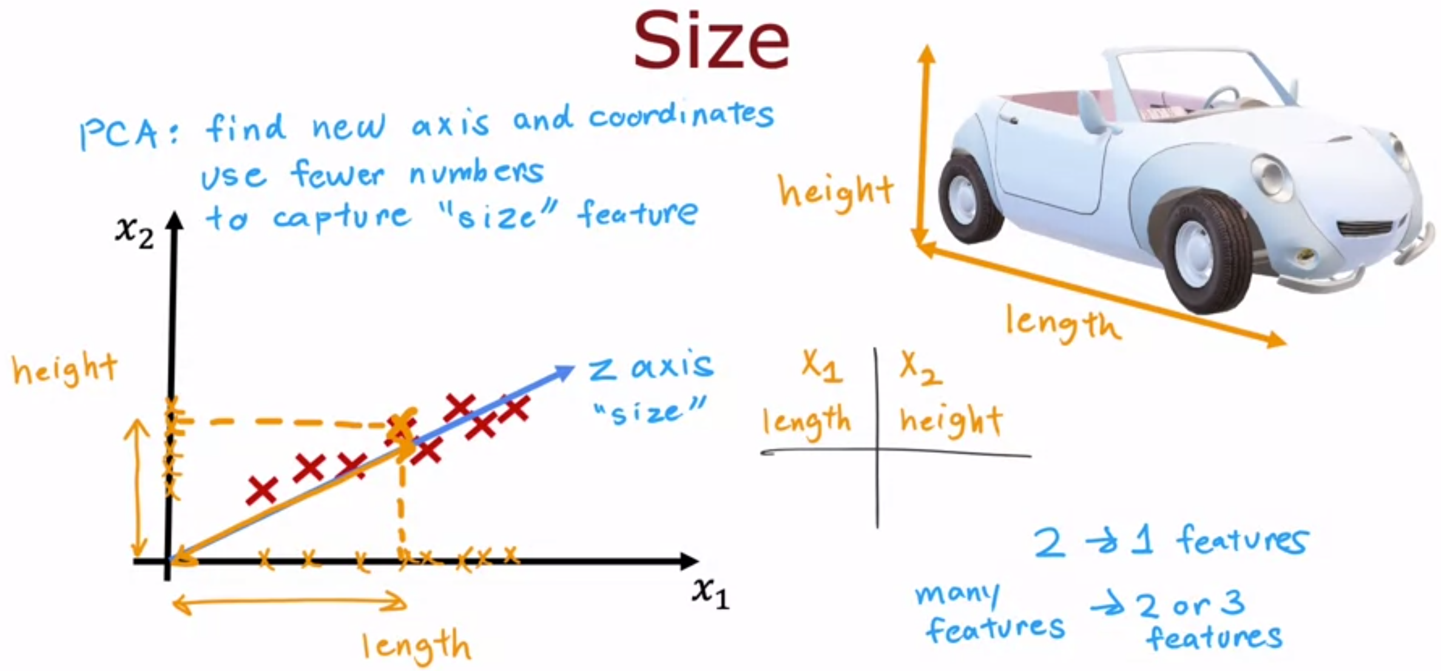
04
Principal Component Analysis (PCA)

Slide 14
PCA Algorithm
05

Slide 15
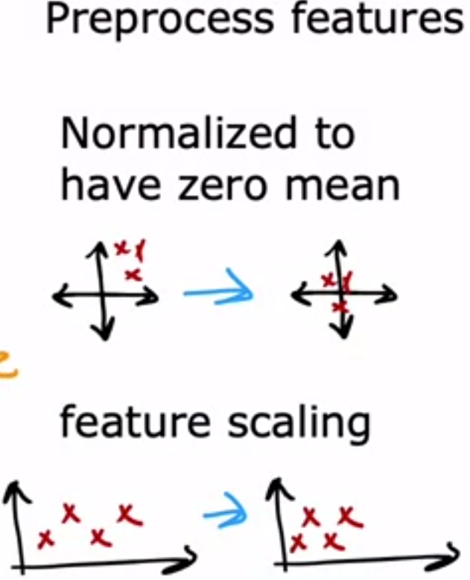
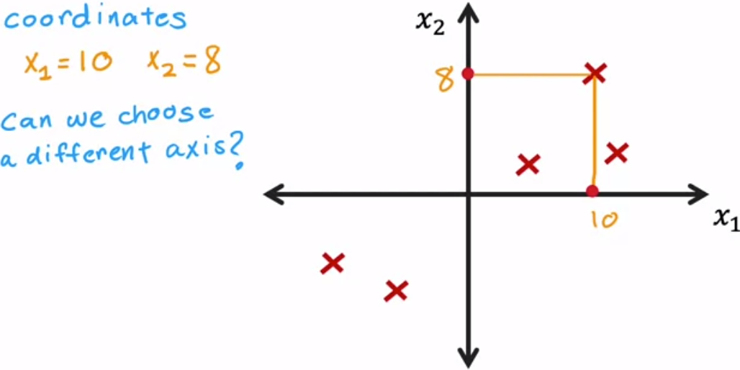
05
Principal Component Analysis (PCA)
The example below has coordinates x₁ equals 10 and x₂ equals 8.
If we don't want to use the x_1, x_2 axes, how can we pick some different axis with which to capture what's in the data or with which to represent the data?
One note on pre-processing, before applying the next few steps of PCA the features should be first normalized to have zero mean by subtracting the mean from each feature .
If the features take on very different scales, then there is need to first perform feature scaling, so the ranges are not too far apart before applying the next few steps of PCA.

Slide 16
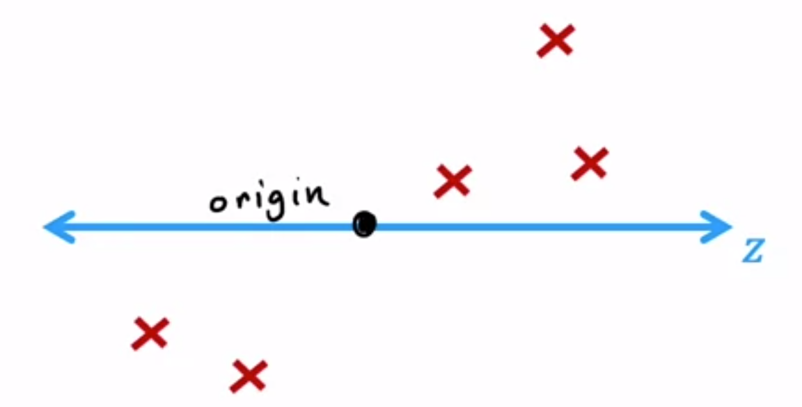
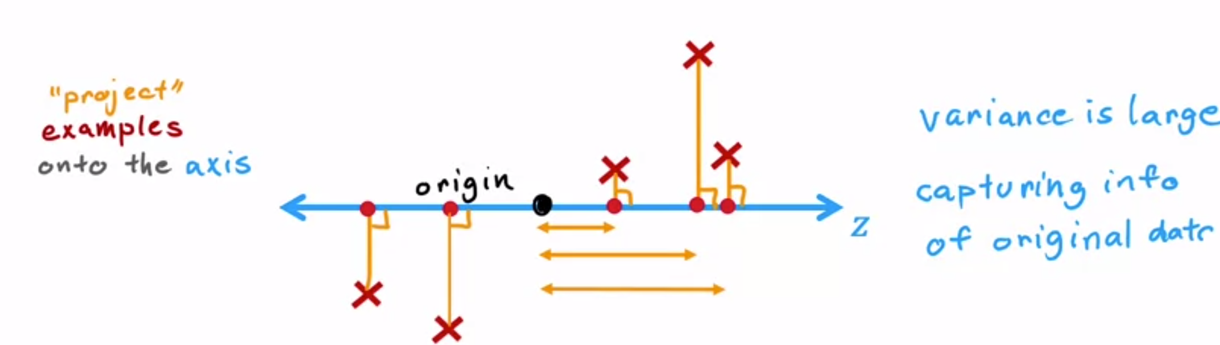
05
Principal Component Analysis (PCA)
Choosing z axis
Let me remove the x₁ and x₂ axes so that we're just left with the five training examples. This dot here represents the origin.
Then use one axis, z-axis (instead of two axes) to capture the important features of those five examples. Another way of saying this is to project these five examples down to z-axis as seen below.
This little box here is used to denote that this line segment is at 90 degrees to the z-axis.
These five points are pretty spread apart so you're still capturing a lot of the variation (information) or a lot of the variance in the original dataset.

Slide 17
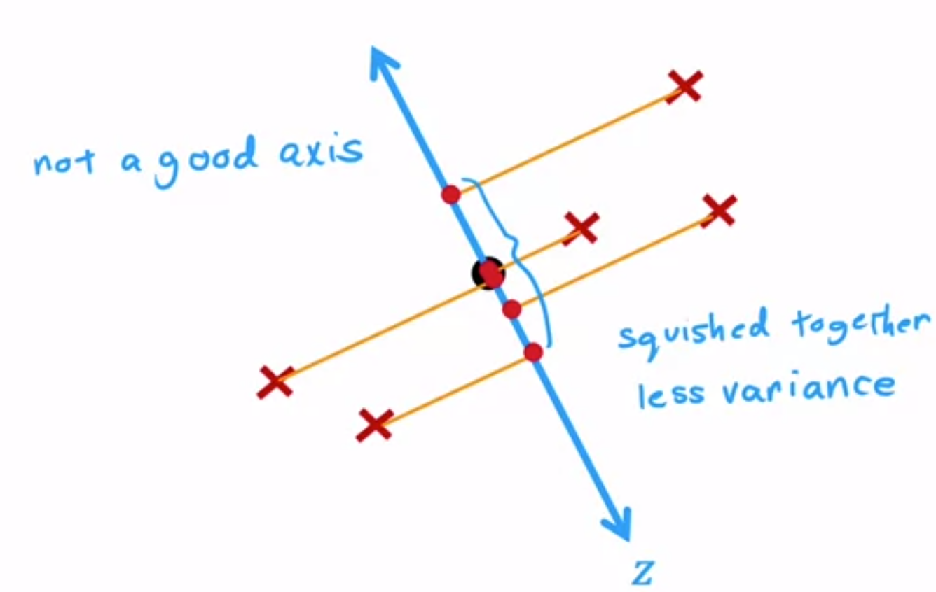
05
Principal Component Analysis (PCA)
Choosing another choice of z-axis
Consider another choice of z-axis which is actually not a great choice.
In this case, take the same five examples and project them down to the z-axis, I end up with these five points as seen below.
You’ll notice that as compared to the previous choice, these five points are quite squished together. Thus, the amount they are differing from each other, or their variance or the variation is much less.
What this means is with this choice of z, you're capturing much less of the information in the original dataset because you've partially squish all five examples together.

Slide 18
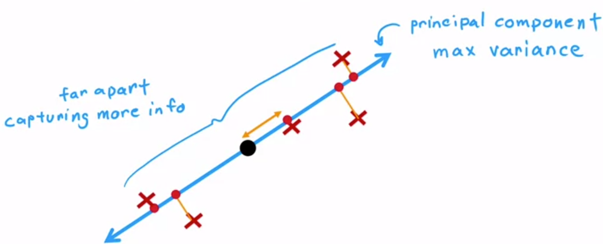
05
Principal Component Analysis (PCA)
Better Choice for z-axis
This is actually a better choice than the previous two shown, because if we take the data's projections onto the z-axis, we find that these dots are actually quite far apart.
We're capturing a lot of the variation, a lot of the information in the original dataset, even though we're now using just one coordinate or one number to represent or to capture each of the training examples instead of two numbers or two coordinates, X₁ and X_{2.}
In the PCA algorithm, this axis is called the principal component.

Slide 19
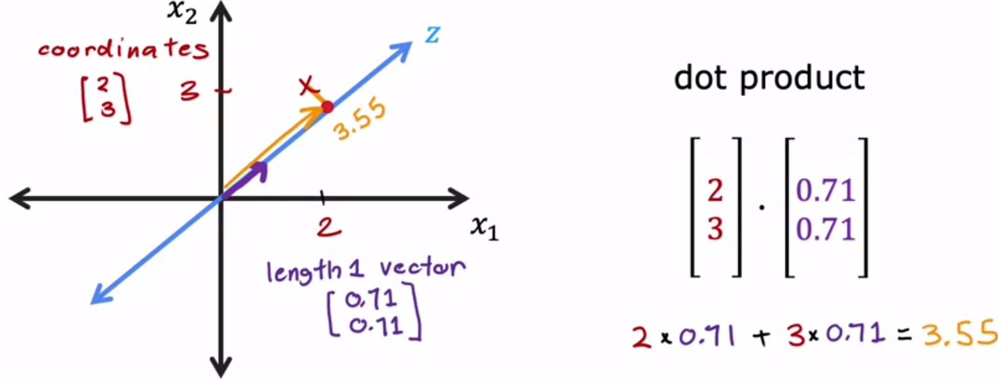
05
PCA - Co-ordinate on the new axis
Given this example with coordinates 2,3 on the x₁, x₂ axis, how do we project this example onto the z-axis? It turns out the formula for doing so is to take a dot product between the vector 2, 3 and this vector 0.71, 0.71.

Slide 20
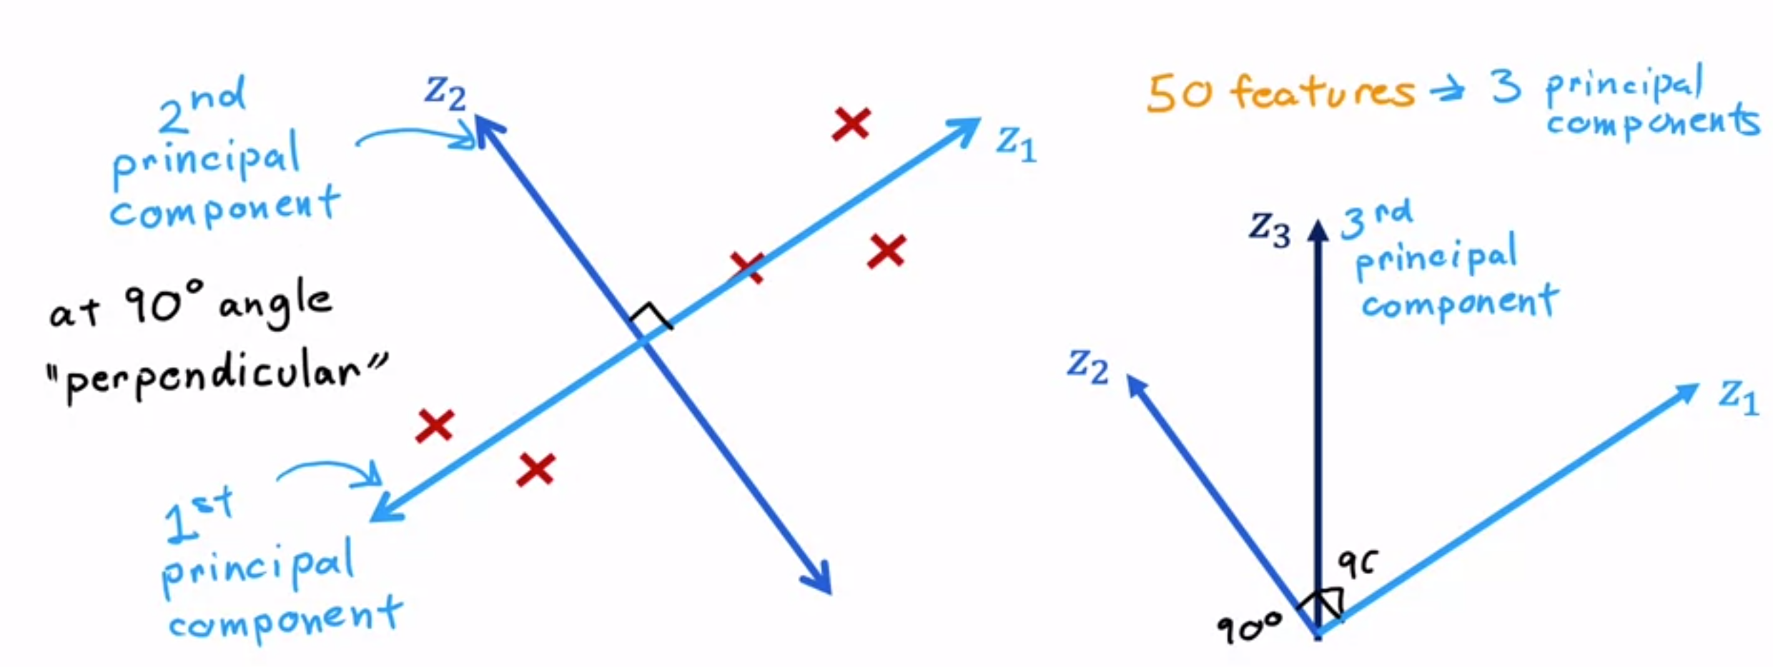
05
PCA – More Principal Components
It turns out that if you were to pick a second axis, the second axis will always be at 90 degrees (perpendicular) to the first axis.
If you were to choose even a third axis, then the third axis will be at 90 degrees (perpendicular) to the first and the second axis

Slide 21
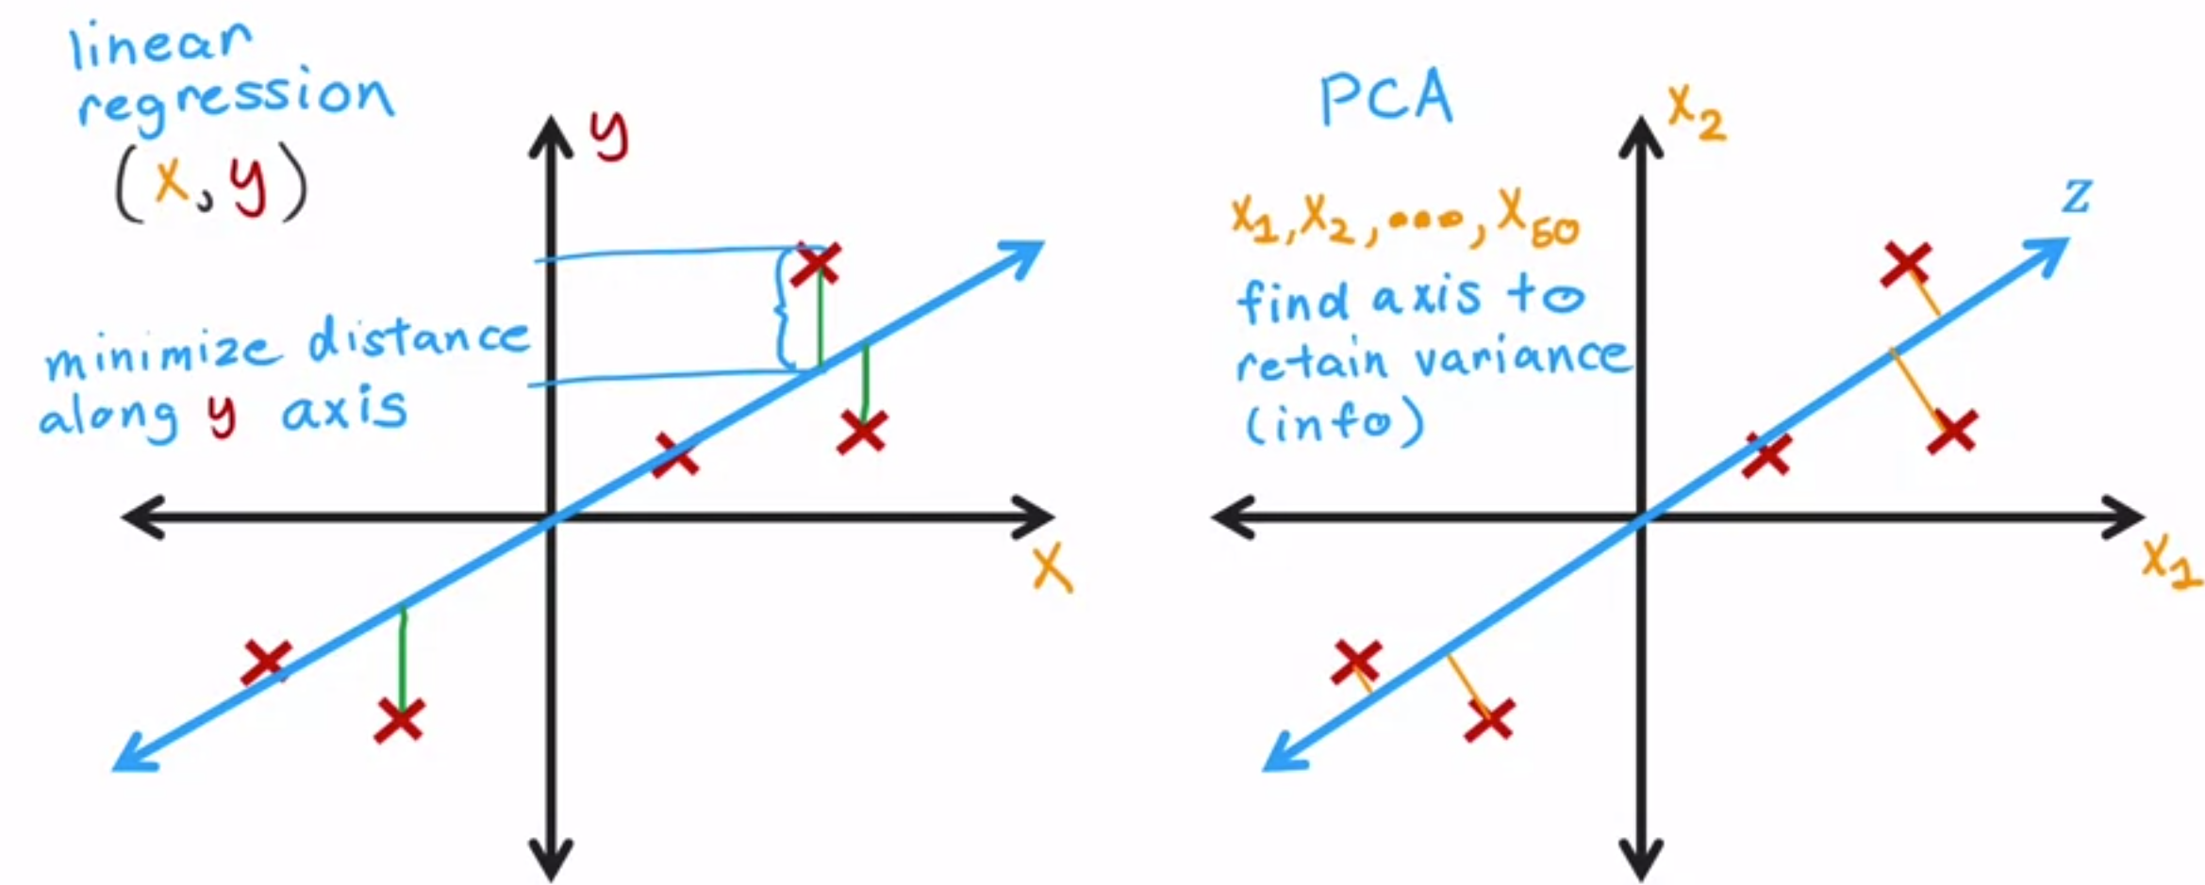
05
Difference between Linear Regression and PCA
Linear regression is used to predict a target output Y and PCA is trying to take a lot of features and treat them all equally and reduce the number of axis needed to represent the data well.
It turns out that maximizing the spread of these projections will correspond to minimizing the distances of these line segments, the distances to the points have to move to be projected down to Z.

Slide 22
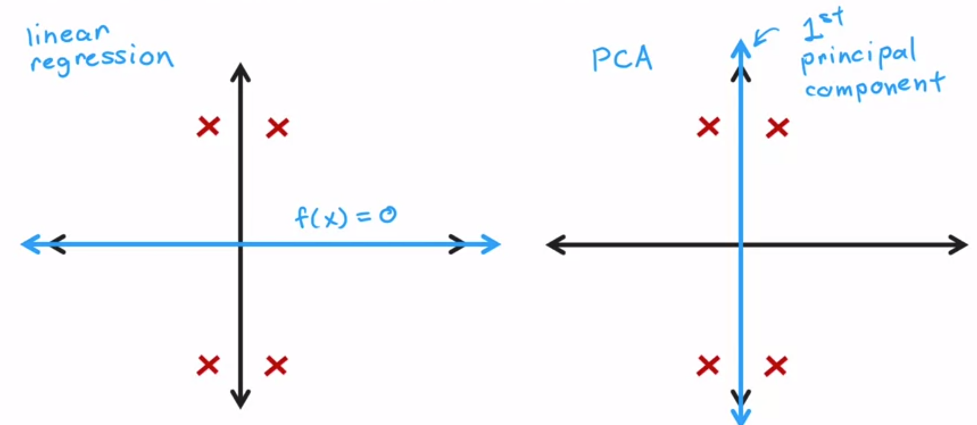
05
Difference between Linear Regression and PCA
Another way is if you have a data set that looks like this, linear regression, all it can do is fit a line that looks like that. Whereas if your data set looks like this, PCA will choose this to be the principal component. So you should use linear regression if you're trying to predict the value of y, and you should use PCA if you're trying to reduce the number of features in your data set, say to visualize it.

Slide 23
PCA in scikit & example
06

Slide 24
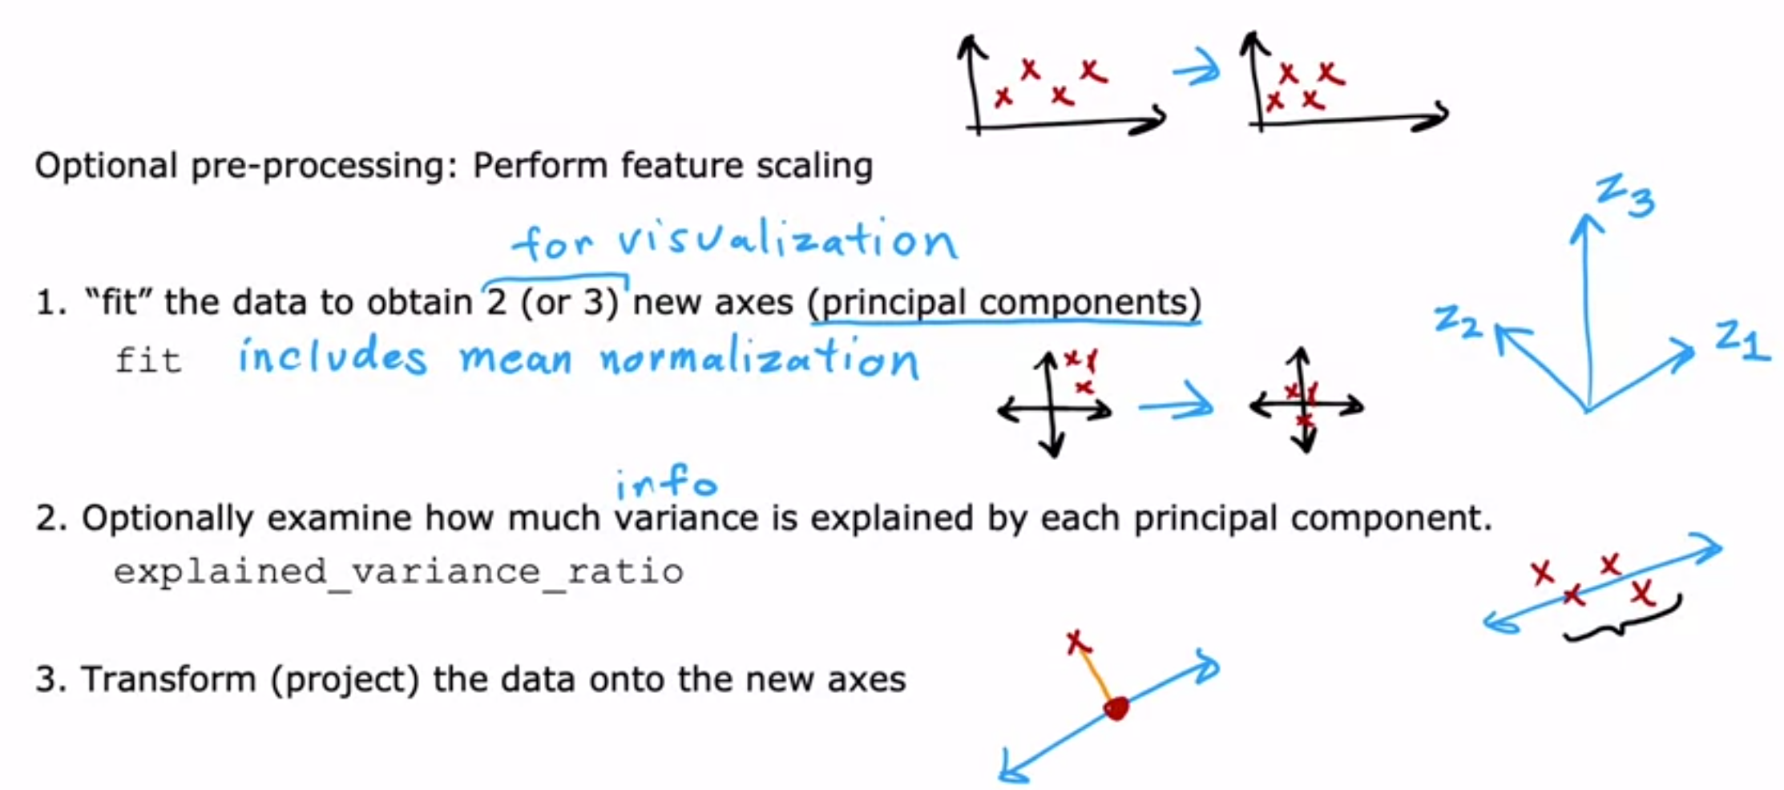
05
PCA in scikit-learn

Slide 25
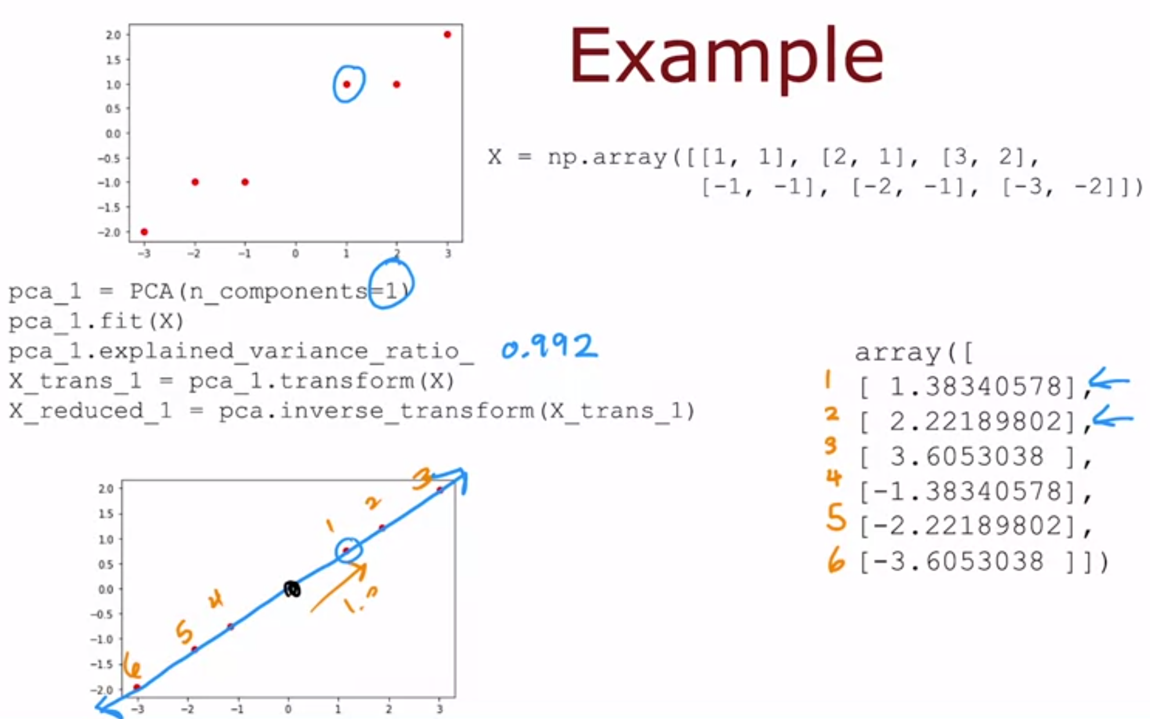
05
PCA in scikit-learn

Slide 26
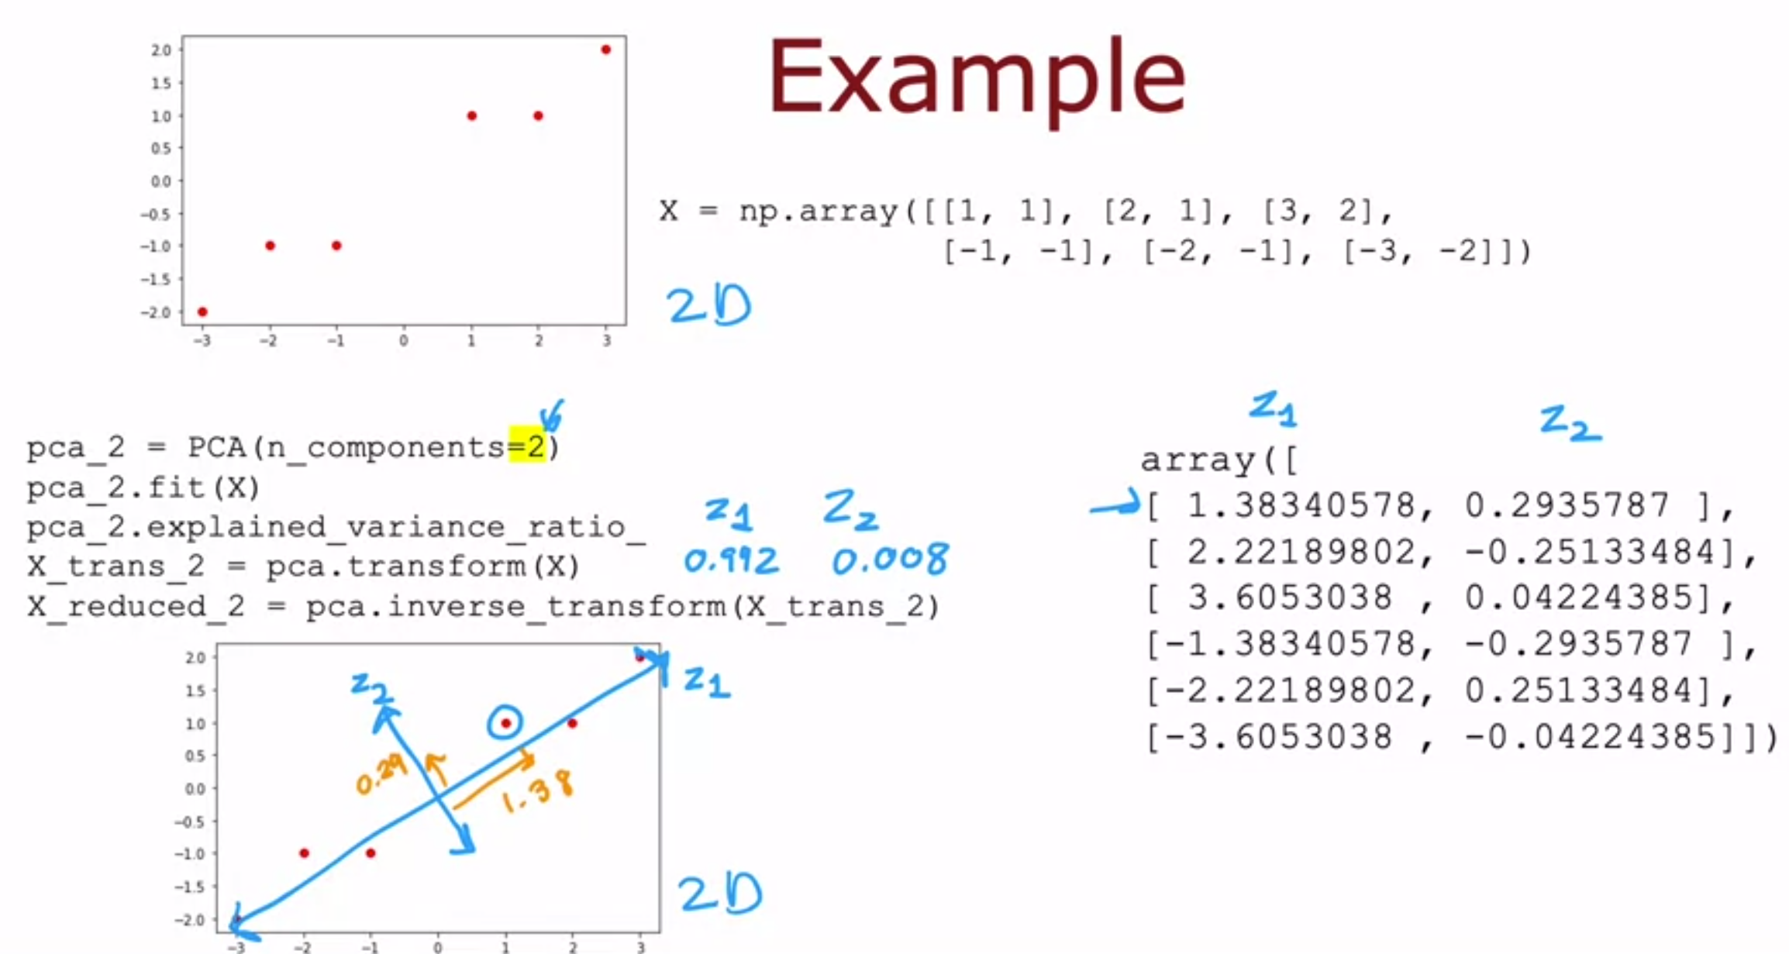
05
PCA in scikit-learn

Slide 27
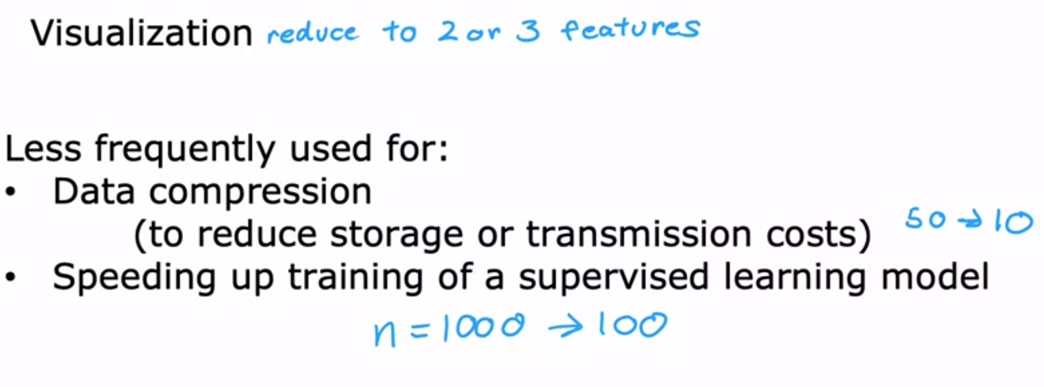
05
Application of PCA

Slide 28
06
Summary of Principal Component Analysis (PCA)
Definition
PCA is an unsupervised dimensionality reduction technique used to transform high-dimensional data into a lower-dimensional space while preserving as much variance as possible.
Objective
PCA identifies the principal components, which are orthogonal directions representing the maximum variance in the data.
How PCA Works
Step 1: Standardize the data to have zero mean and unit variance.
Step 2: Calculate the covariance matrix to find the relationships between features.
Step 3: Compute the eigenvectors and eigenvalues of the covariance matrix.
Step 4: Sort the eigenvalues in descending order and choose the top k eigenvectors (principal components).
Step 5: Project the data onto the selected principal components to obtain the lower-dimensional representation.
Reference Book: Hands on Machine Learning with Scikit Learn and TensorFlow

Slide 29
07
PCA - Explained Variance and Choosing k
Explained Variance: The percentage of variance explained by each principal component.
Choosing k: Selecting the minimum k that retains enough variance (e.g., 95%) in the data.
Advantages and Disadvantages of PCA
Advantages: Reduces data dimensionality, removes multicollinearity, and simplifies subsequent analyses.
Disadvantages: Interpretability of principal components may be challenging, and PCA may not be suitable for some non-linear datasets.
Reference Book: Hands on Machine Learning with Scikit Learn and TensorFlow

Slide 30
Seminar session
1 & 2
07

Slide 31
Seminar 1- PCA Unsupervised Learning
07
PCA Case Study: Iris Flower Dimensionality Reduction
In this case study, we will use the Iris dataset to perform PCA for dimensionality reduction, transforming the four-dimensional feature space into a two-dimensional space.
Dataset Description:
The dataset contains four features (sepal length, sepal width, petal length, and petal width) and three classes (setosa, versicolor, and virginica).
Note: Make sure to have the required dataset ('iris.csv') and install necessary libraries (e.g., scikit-learn, pandas, matplotlib) before running the code.
Code for PCA Dimensionality Reduction:
#Step 1: Import Required Libraries
import pandas as pd
from sklearn.decomposition import PCA
import matplotlib.pyplot as plt
import seaborn as sns

Slide 32
Seminar 1 (cont’d)- PCA Unsupervised Learning
07
#Step 2: Load and Explore the Dataset
#Define your own column names
column_names = ['SL', 'SW', 'PL', 'PW', 'species']
# Load the dataset (replace 'iris.csv' with the actual dataset file)
data = pd.read_csv('iris.data', header=None, names=column_names)
# Explore the dataset
print(data.head())
print(data.info())
#Step 3: Data Preprocessing
# Separate features (X) and target variable (y)
X = data.drop('species', axis=1) #axis=1 handled all the column, while axis = 0 is for the row
#X= data.iloc[:, :-1]
# Standardize the data
from sklearn.preprocessing import StandardScaler
scaler = StandardScaler()
X_scaled = scaler.fit_transform(X)

Slide 33
Seminar 1 (cont’d)- PCA Unsupervised Learning
07
#Step 4: Perform PCA for Dimensionality Reduction
# Initialize PCA with the desired number of components (e.g., 2)
pca = PCA(n_components=2)
# Fit and transform the data to the lower-dimensional space
X_pca = pca.fit_transform(X_scaled)
#Step 5: Visualize the Data in the Reduced Dimensional Space
# Create a DataFrame for visualization
pca_df = pd.DataFrame(data=X_pca, columns=['Principal Component 1', 'Principal Component 2'])
pca_df['species'] = data['species']
# Visualize the data
plt.figure(figsize=(8, 6))
sns.scatterplot(x='Principal Component 1', y='Principal Component 2', hue='species', data=pca_df, palette='Set1')
plt.title('PCA: Iris Flower Dimensionality Reduction')
plt.show()

Slide 34
In this practical session, we performed the following steps:
1. Imported necessary libraries.
2. Loaded and explored the dataset.
3. Preprocessed the data by separating features and target variable, and splitting it into training and testing sets.
4. Built and trained a Decision Tree model with a specified maximum depth.
5. Made predictions on the test set and evaluated the model's performance using accuracy and a classification report.
6. Optionally, visualized the Decision Tree using graphviz for better understanding.
Note: Make sure to have the required dataset ('heart.csv') and install necessary libraries (e.g., scikit-learn, pandas, graphviz) before running the code.
Seminar 1 (cont’d)- PCA Summary
07
In this practical session, we performed the following steps:
Imported necessary libraries.
Loaded and explored the Iris dataset.
Preprocessed the data by standardizing it to have zero mean and unit variance.
Performed PCA for dimensionality reduction and transformed the data into a lower-dimensional space (two dimensions).
Visualized the data in the reduced dimensional space to observe the separation between classes..

Slide 35
Thanks for Listening

